Slide 1


Introduction
ACCESSDATA® FORENSICS
CASE REPORTING
Forensic Analysis
Incident Response
eDiscovery
Information Assurance

Slide 2
Module Objectives
Generating a Report
  Case Information
  Bookmarks
  Thumbnail Section
  File Management
  Registry Parser
  Location and Presentation
Report Distribution
Notes:
June 25, 2003 - Module 4 Jeremy's edits Jon's modifications of June 25 new numbers

Slide 3
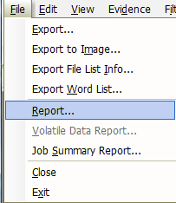

Generating a Report
Notes:
June 25, 2003 - Module 4 Jeremy's edits Jon's modifications of June 25 new numbers

Slide 4
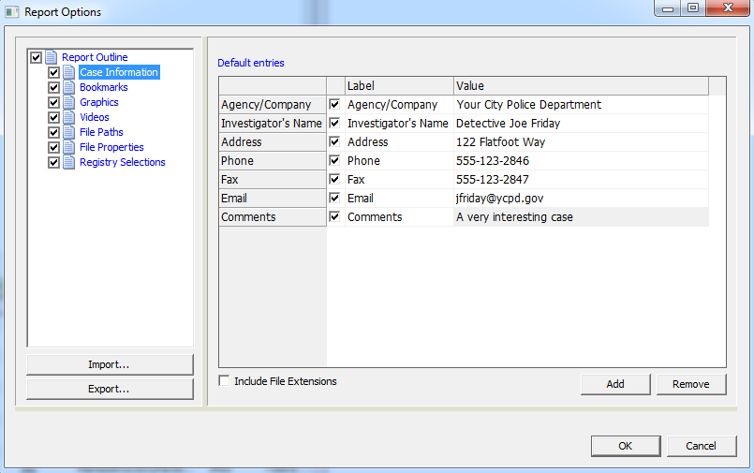
Case Information
Each section is optional.
Select the sections you want to add to the report.
Notes:
June 25, 2003 - Module 4 Jeremy's edits Jon's modifications of June 25 new numbers

Slide 5
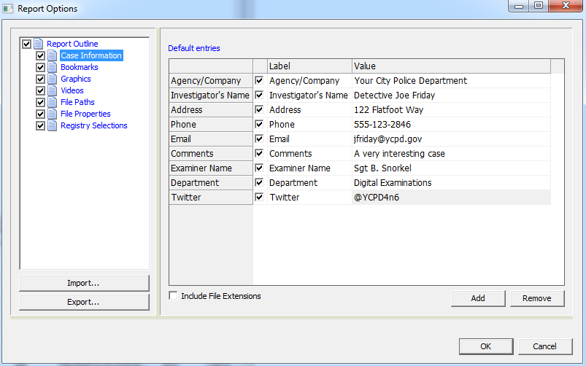
Case Information
Change and add labels as you need
Notes:
June 25, 2003 - Module 4 Jeremy's edits Jon's modifications of June 25 new numbers

Slide 6
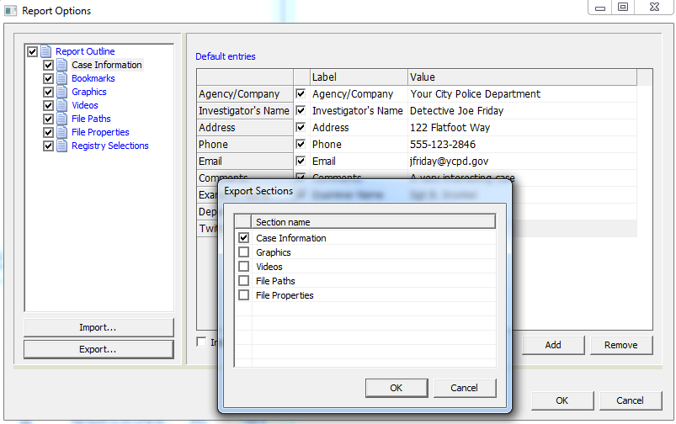
Case Information
Export as a Template for Future Cases
Notes:
June 25, 2003 - Module 4 Jeremy's edits Jon's modifications of June 25 new numbers

Slide 7
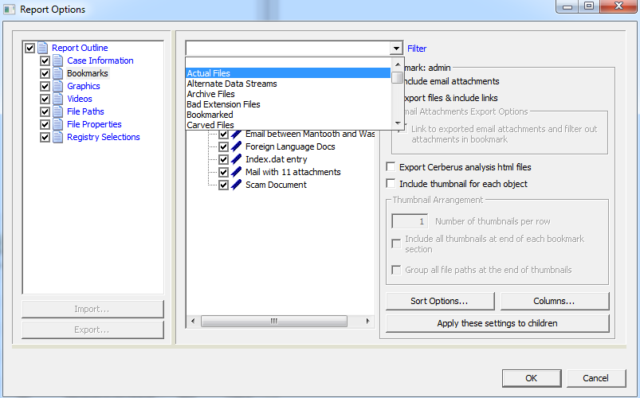
Bookmarks
Notes:
June 25, 2003 - Module 4 Jeremy's edits Jon's modifications of June 25 new numbers

Slide 8
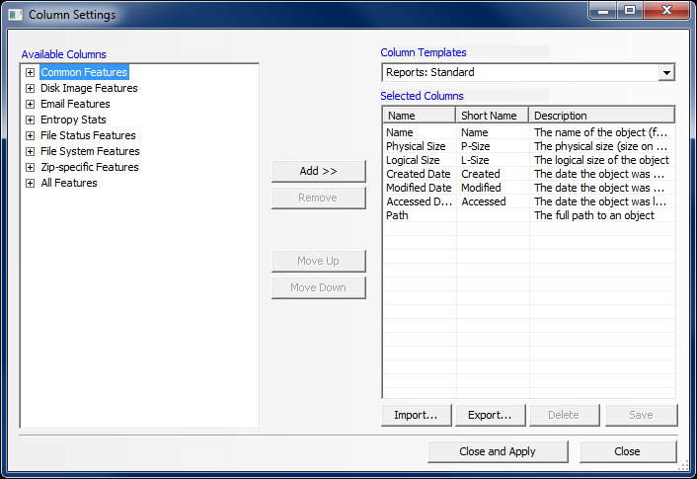
Bookmarks
Notes:
June 25, 2003 - Module 4 Jeremy's edits Jon's modifications of June 25 new numbers

Slide 9
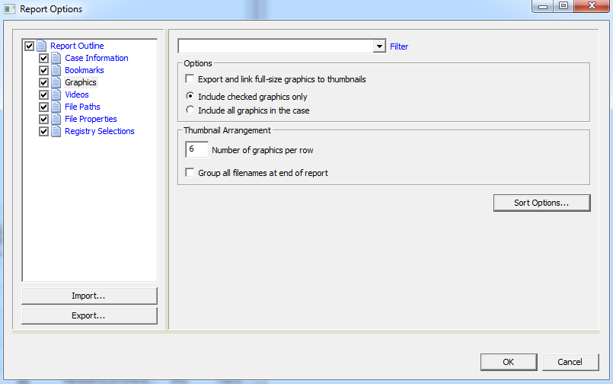
Thumbnail Section
Notes:
June 25, 2003 - Module 4 Jeremy's edits Jon's modifications of June 25 new numbers

Slide 10
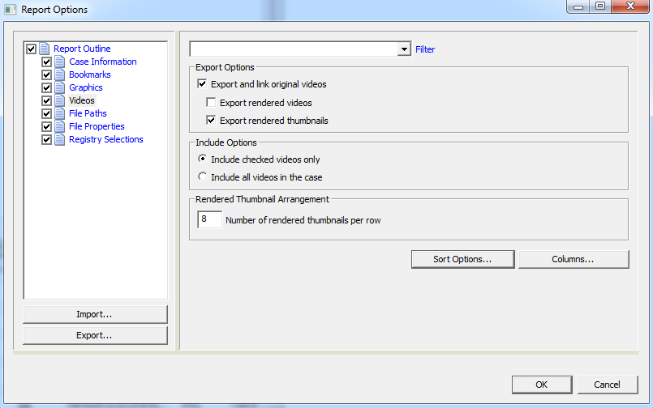
Videos Section
Notes:
June 25, 2003 - Module 4 Jeremy's edits Jon's modifications of June 25 new numbers

Slide 11
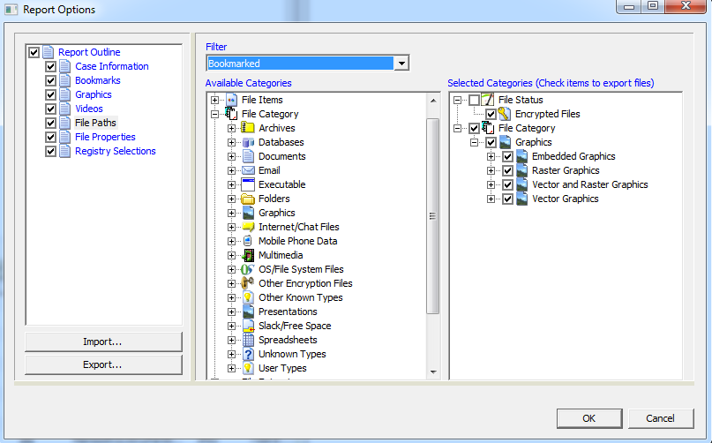
File Paths
Notes:
June 25, 2003 - Module 4 Jeremy's edits Jon's modifications of June 25 new numbers

Slide 12
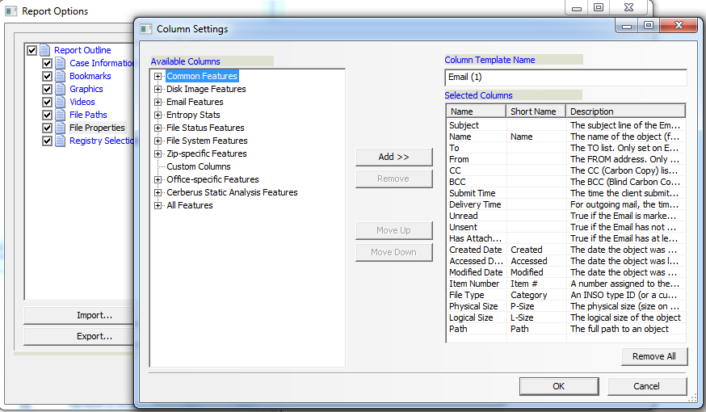
File Properties
Notes:
June 25, 2003 - Module 4 Jeremy's edits Jon's modifications of June 25 new numbers

Slide 13
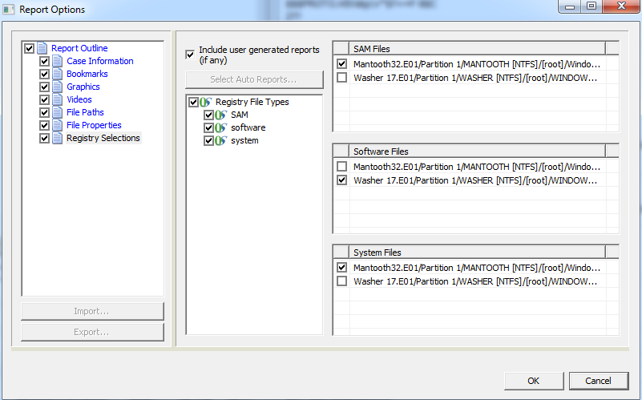
Registry Reports

Slide 14
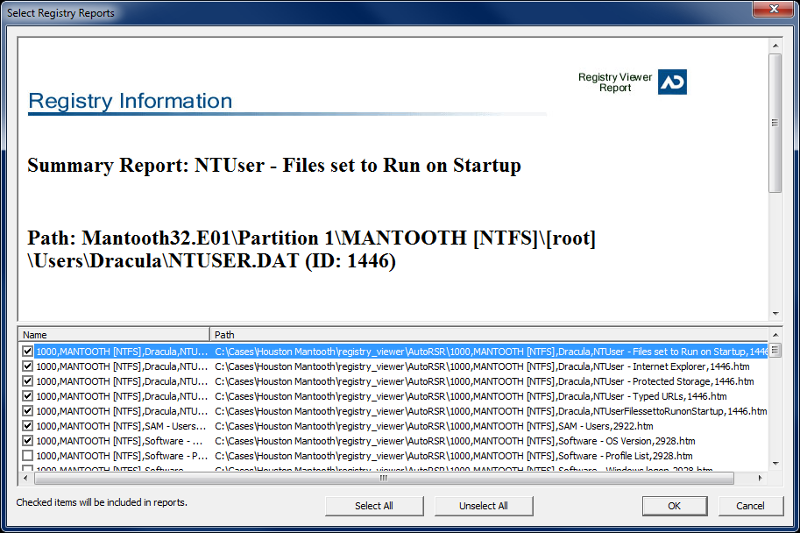
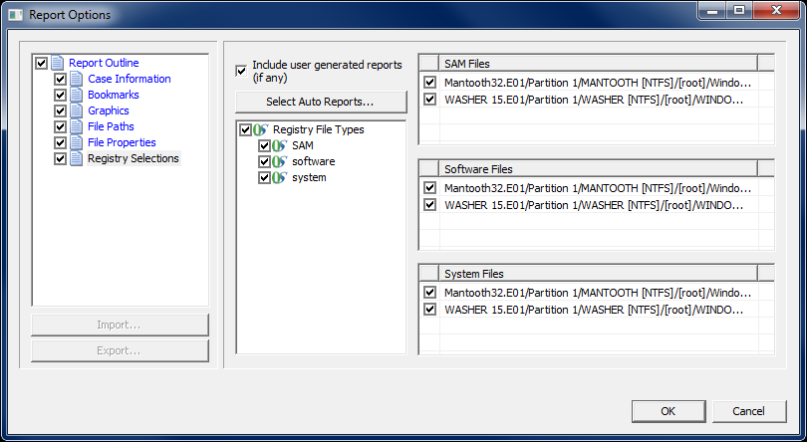
Registry Reports
Notes:
June 25, 2003 - Module 4 Jeremy's edits Jon's modifications of June 25 new numbers

Slide 15
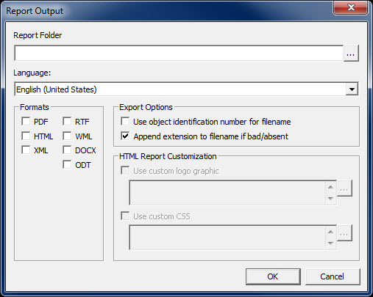
Report Output
Notes:
June 25, 2003 - Module 4 Jeremy's edits Jon's modifications of June 25 new numbers

Slide 16
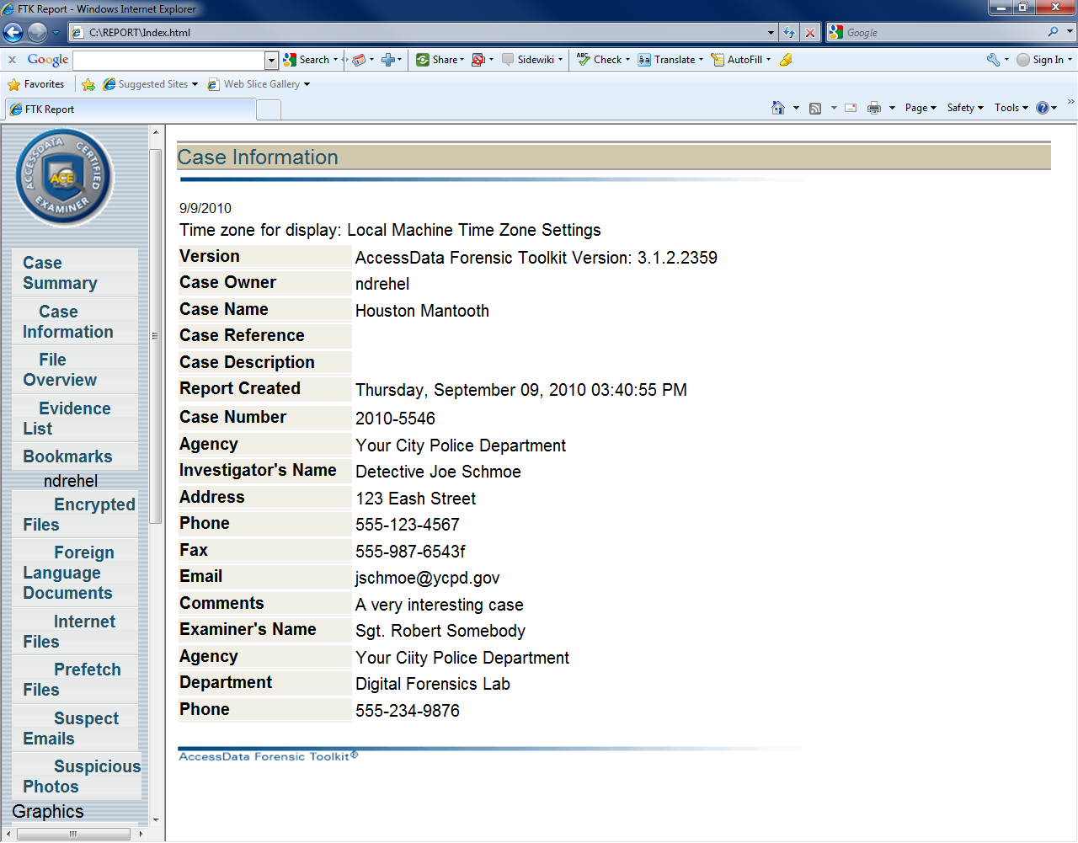
Case Report
Notes:
June 25, 2003 - Module 4 Jeremy's edits Jon's modifications of June 25 new numbers

Slide 17

Report Distribution
Portable Media
Email
Printed Copy
Notes:
June 25, 2003 - Module 4 Jeremy's edits Jon's modifications of June 25 new numbers

Slide 18
Module Objectives
Generating a Report
  Case Information
  Bookmarks
  Thumbnail Section
  File Management
  Registry Parser
  Location and Presentation
Report Distribution
Notes:
June 25, 2003 - Module 4 Jeremy's edits Jon's modifications of June 25 new numbers

Slide 19



